Slide 1

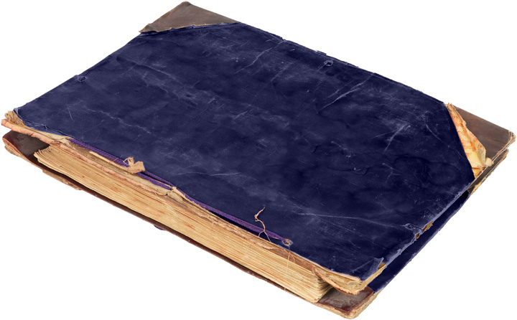

Slide 2

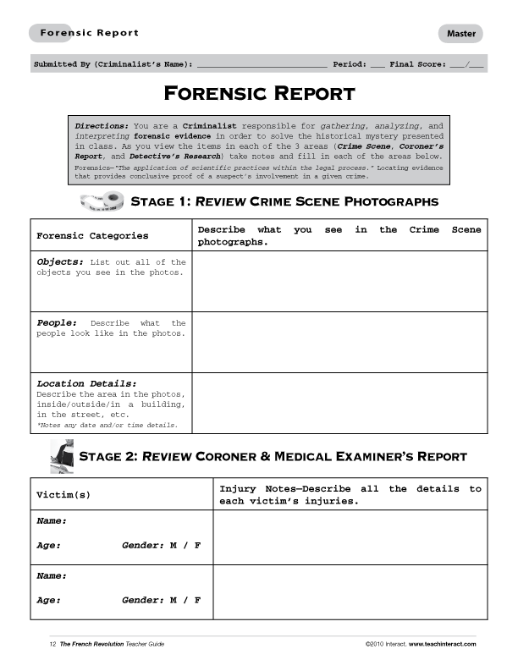
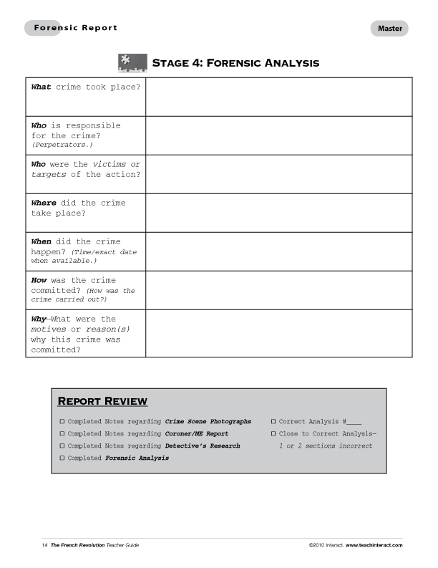
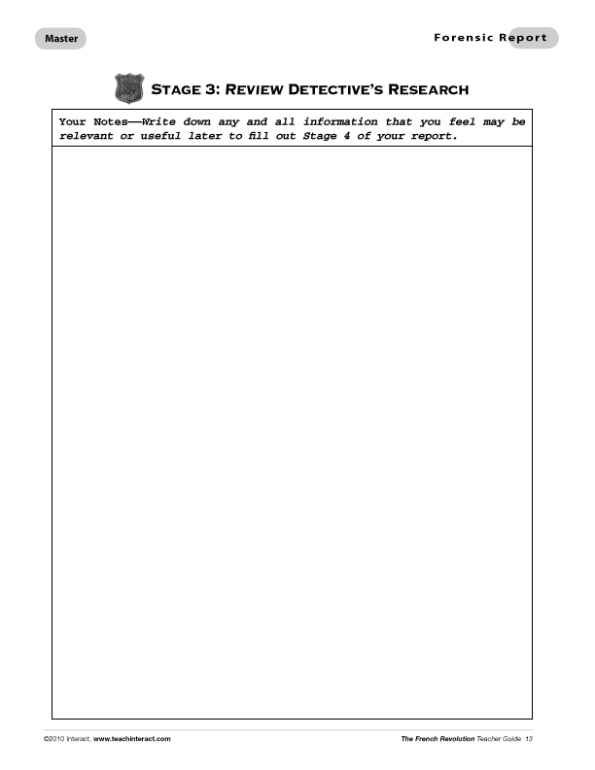
In order to solve a History Mystery you will need
to have a Forensic Report, a Mystery File,
a pen/pencil, and a open mind.
Before you begin, let’s take a moment to
review all the sections of the Forensic Report
so that you are familiar with all the areas of the file
and what you need to do.
Keep in mind that as you review the
items in the file, you are acting as if
you are a Criminalist responsible
for gathering, analyzing, and
interpreting forensic evidence.
These actions are key to helping
you solve the historical mystery
presented in class. Good Luck!

Slide 3
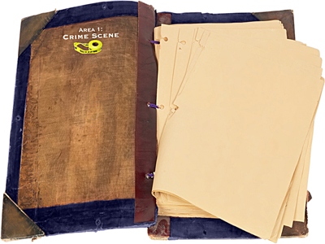

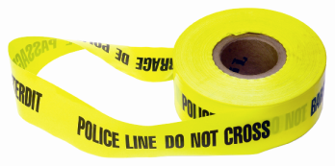
As you view the items in each of the three areas (Crime Scene, Coroner’s Report, and Detective’s Research) take notes and fill in each of the areas on the Forensic Report.
Pay close attention to which office
is reporting information and match
the photos on your file with the photo on your report when you are writing in your information.
For example, if you see the symbol for the Crime Scene office on the top of the file page, you may use that information
to answer the questions about the Crime Scene in your Forensics Report.

Slide 4


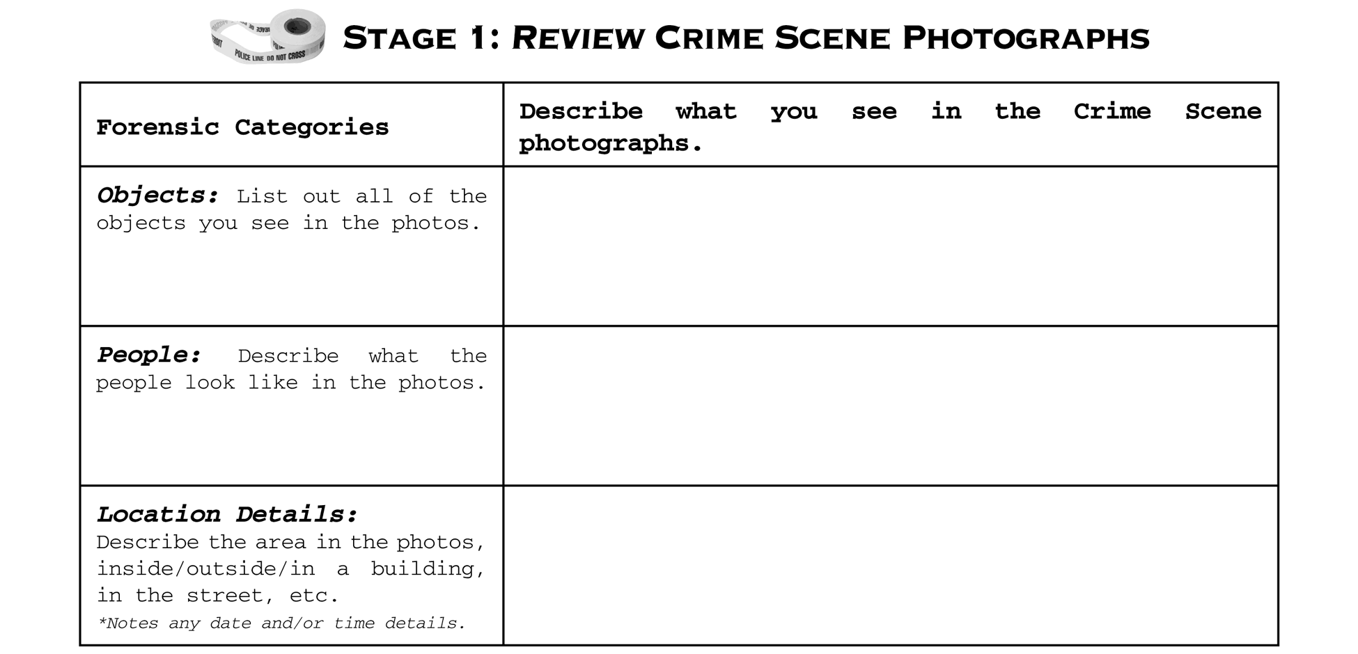
If you are looking at notes and photos about the Crime Scene, they will be marked with a photo of caution tape.
Fill in your report sheet for this section by writing in notes about all the objects, people, and location details that you see.

Slide 5

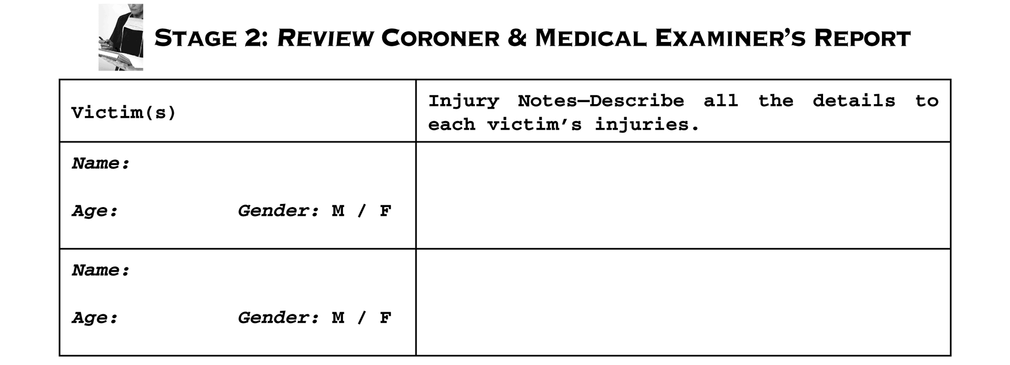
If you are looking at documents and photos with specific information about the victim’s body, then these are part of the Coroner’s Report and they will be marked with a photo of a coroner writing a report.
Fill in your report sheet for this section by writing in specific information about each recovered body. Note the person’s name, gender, age and injury information.

Slide 6

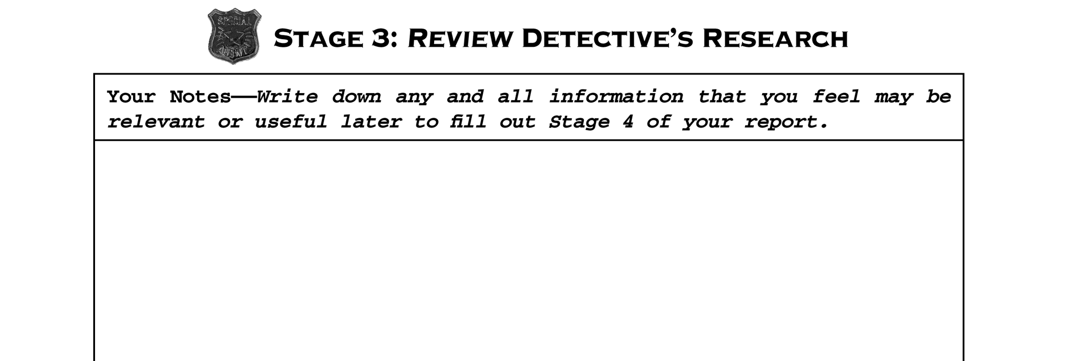
And if you are looking at notes, documents, and/or images from the Detective’s Research they will be marked with a photo of an investigator’s badge.
Fill in your report sheet for this section by writing down any and all information that you feel may
be useful to you later when you fill out Stage 4.

Slide 7
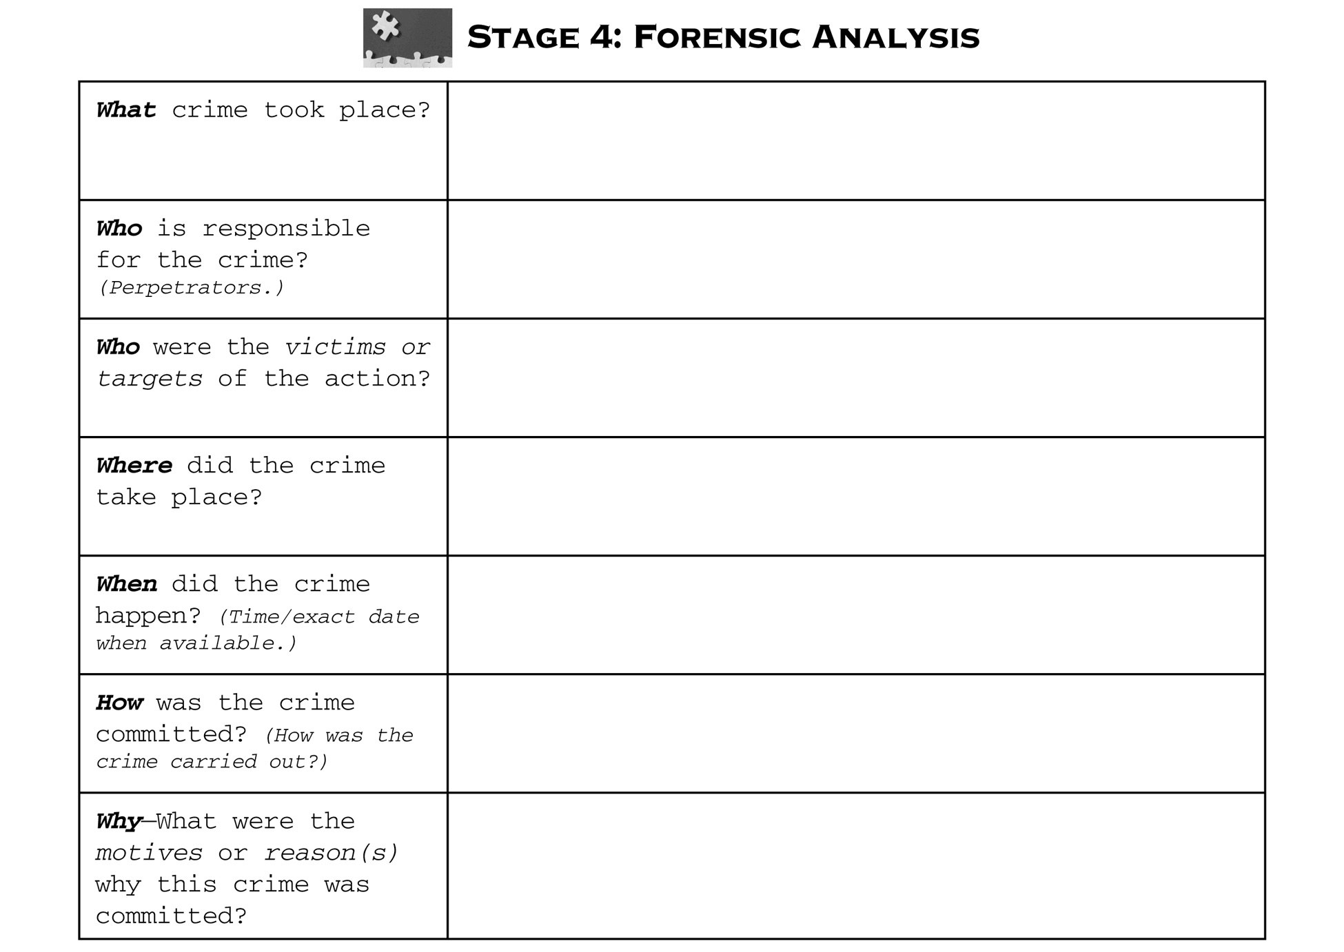
Once you have filled in Stages 1–3 you then use this information to come up with a theory of what event you think took place and why.
Read through carefully and answer each question in Stage 4: Forensic Analysis.

Slide 8

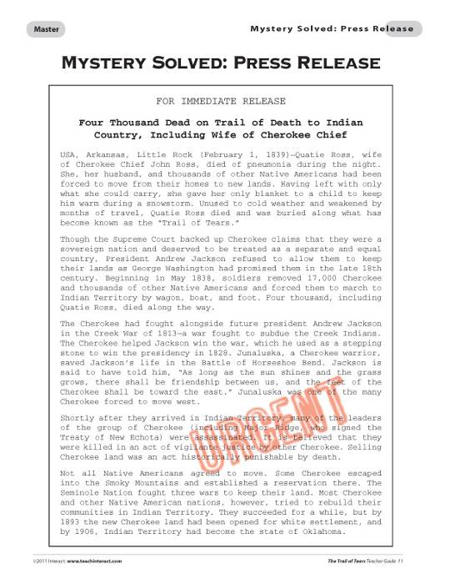
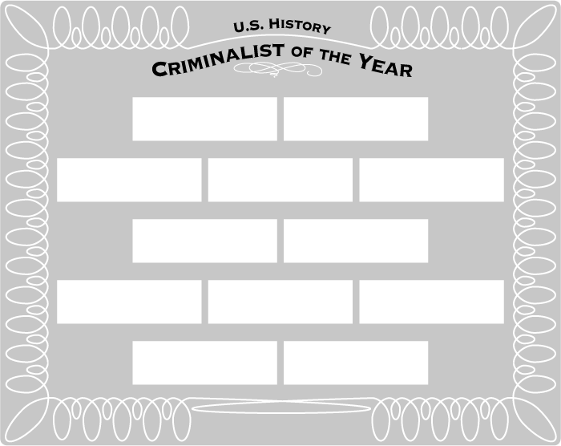
Once you have completed reviewing the entire file and have filled out all of the sections of the Forensics Report, you may then turn
in your report to your teacher.
The first student (or team) who is the
most accurate with their analysis for
this History Mystery will become the
“Criminalist of the Month” and receive
a name plate on the class plaque.
Finally, once the entire class has turned
in their reports, you will read a Mystery Solved: Press Release that will tell
you the background behind the case
you just finished reviewing.

Slide 9






Slide 10

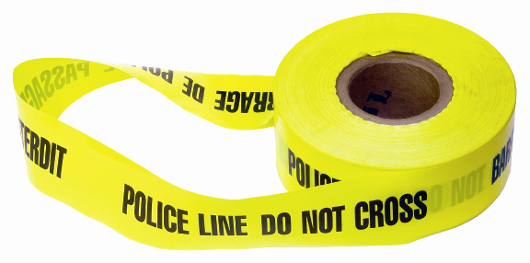

Slide 11



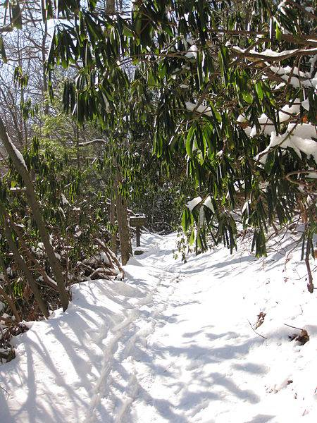
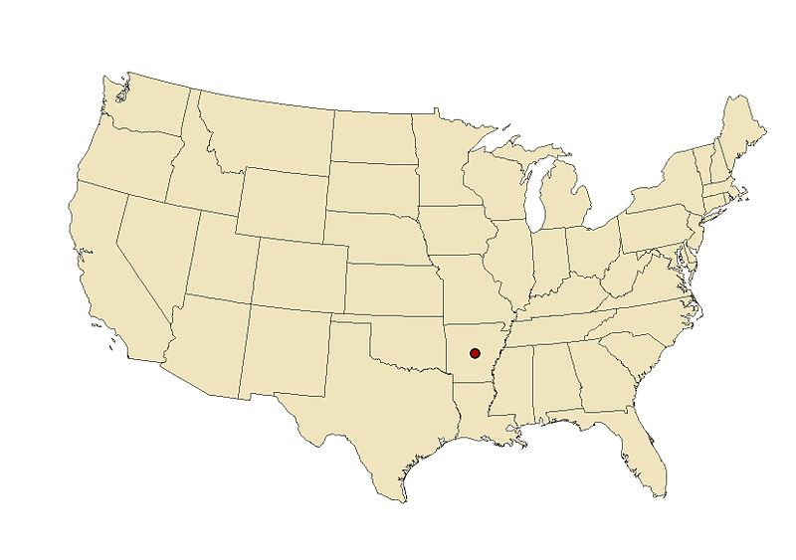

Slide 12



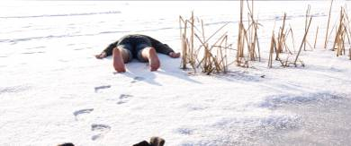

Slide 13



Slide 14
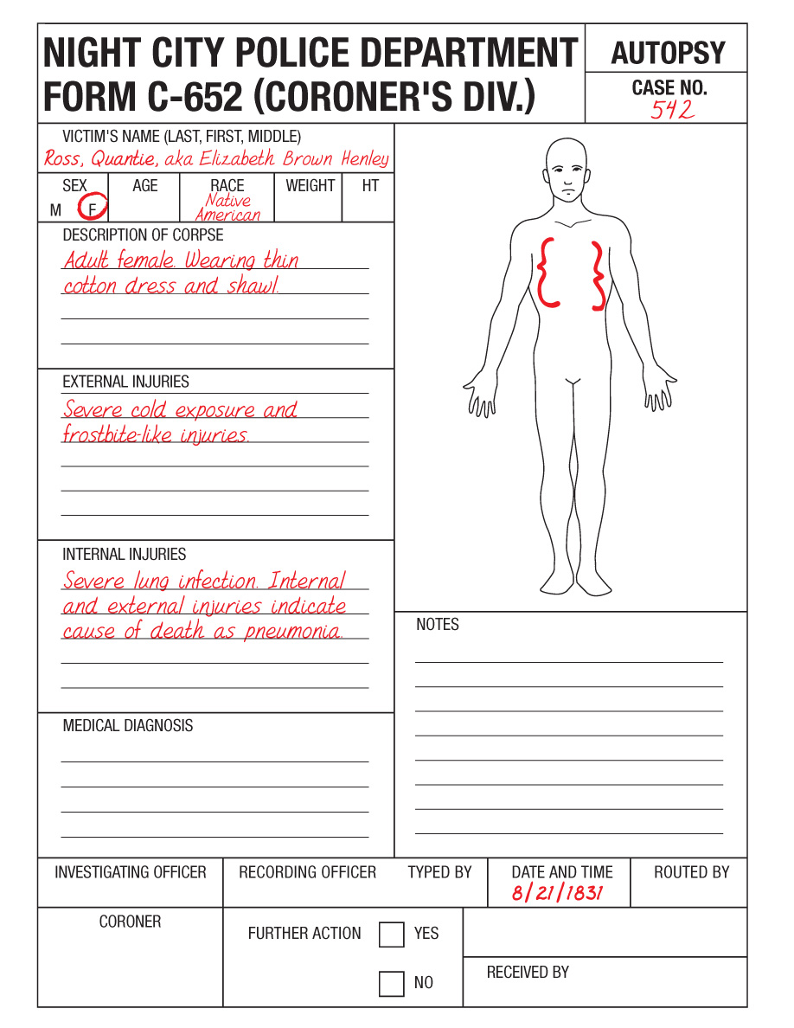



Slide 15



Slide 16



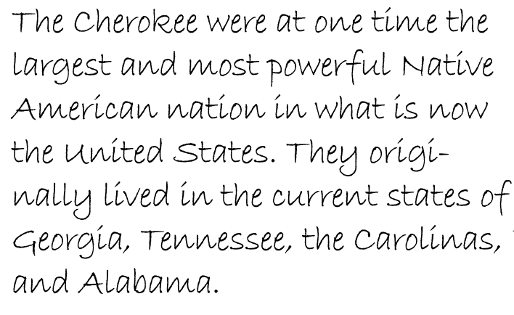
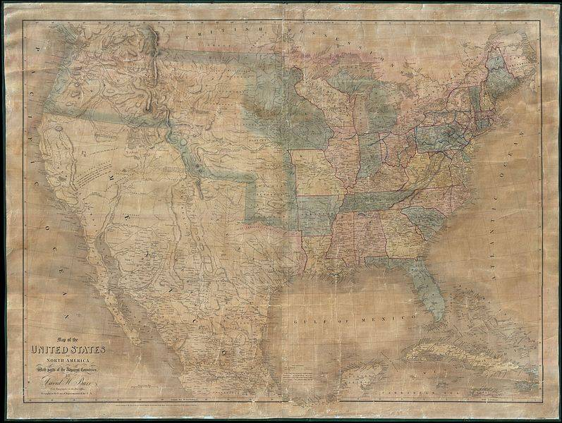


Slide 17

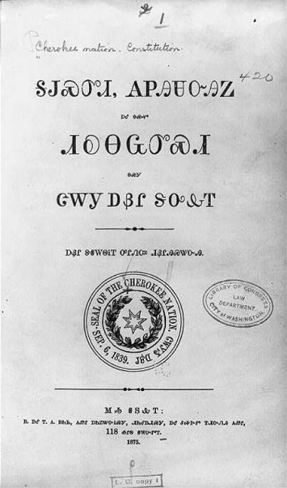
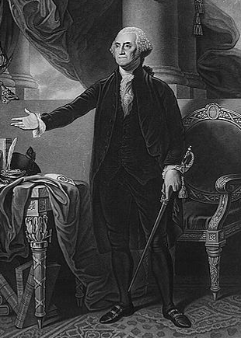
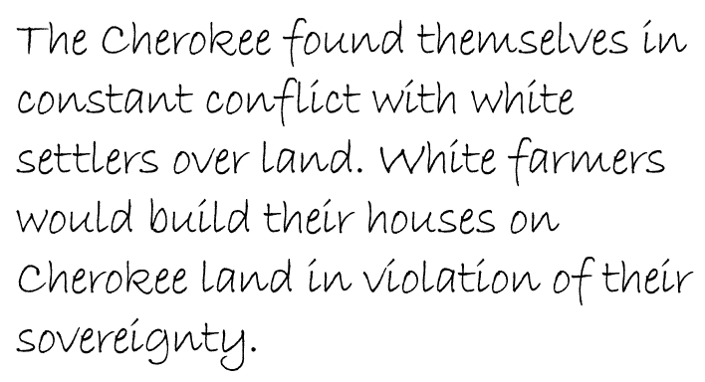
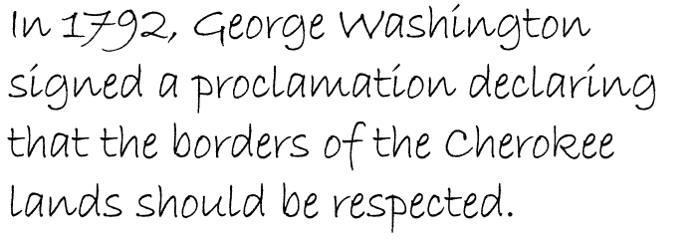


Slide 18
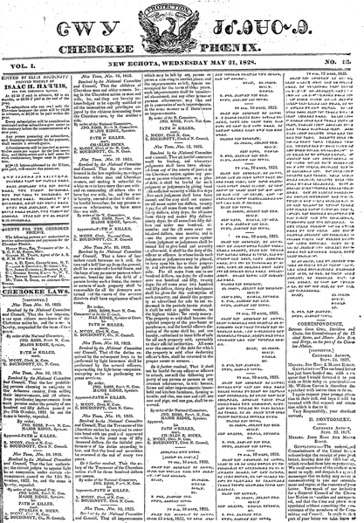


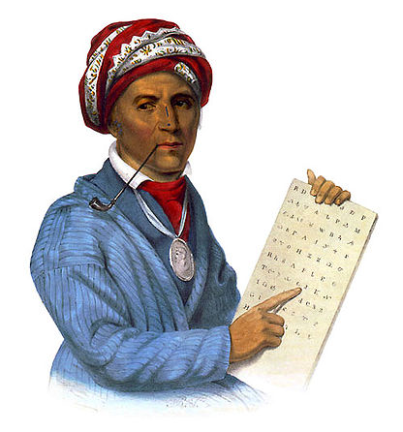

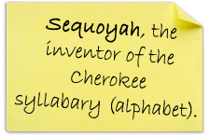

Slide 19
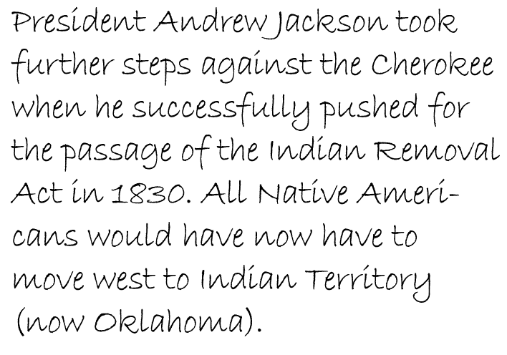

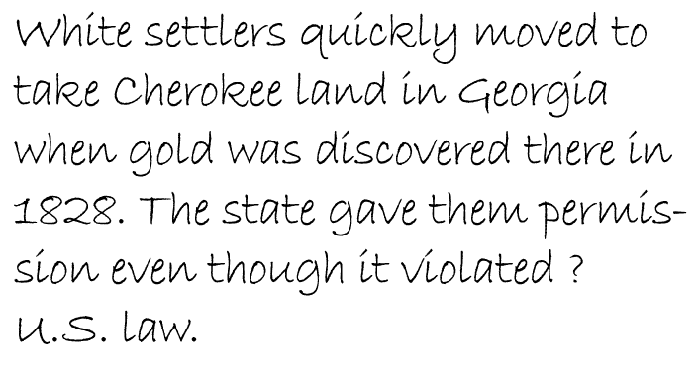
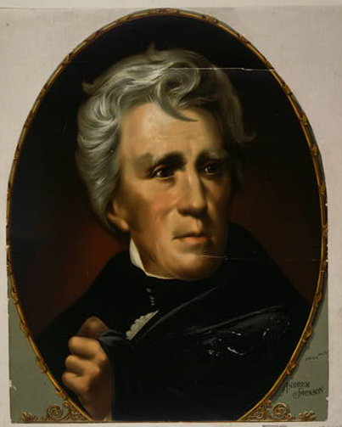
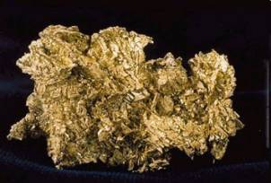


Slide 20
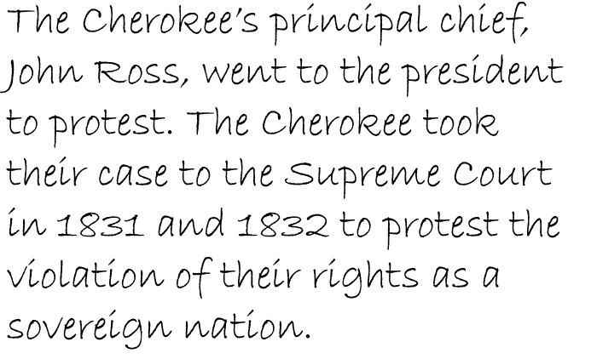
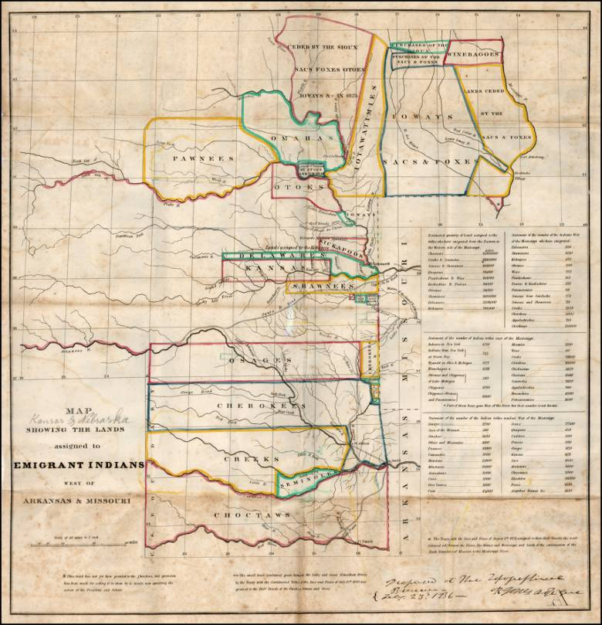
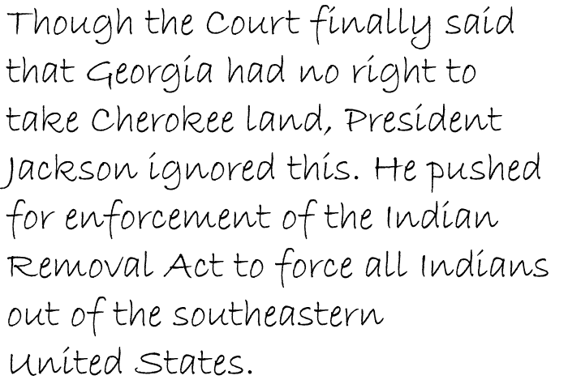

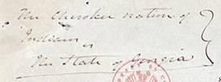

Slide 21
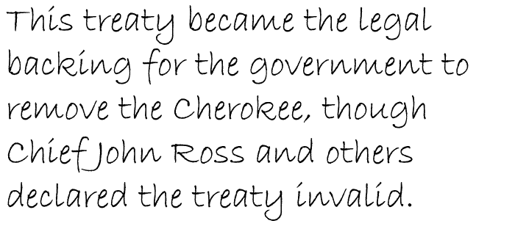
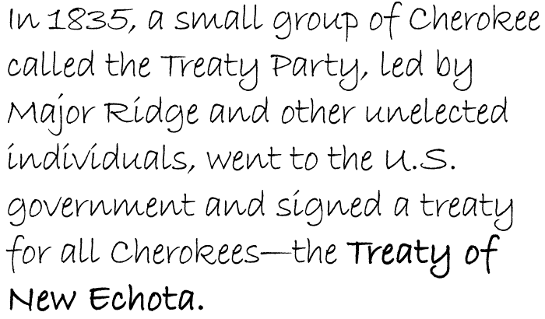
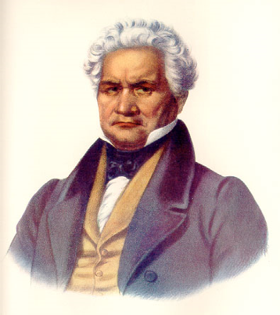
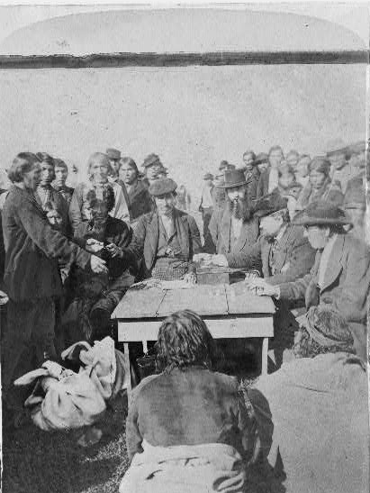



Slide 22
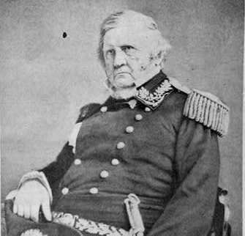

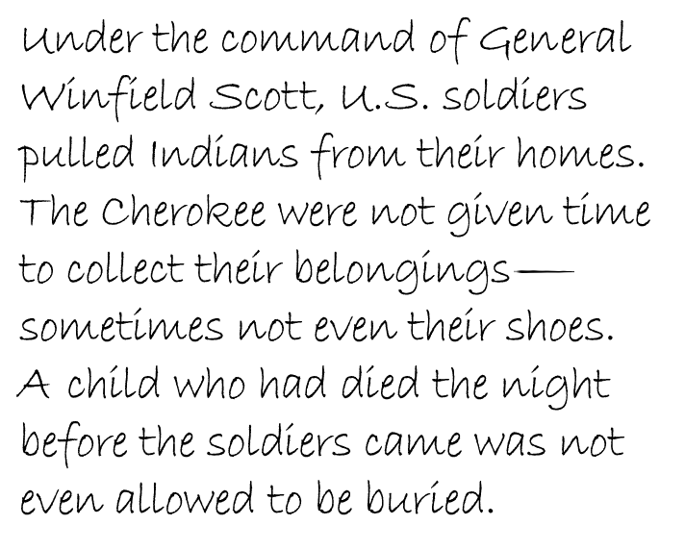
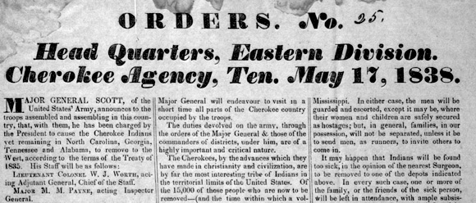

Slide 23
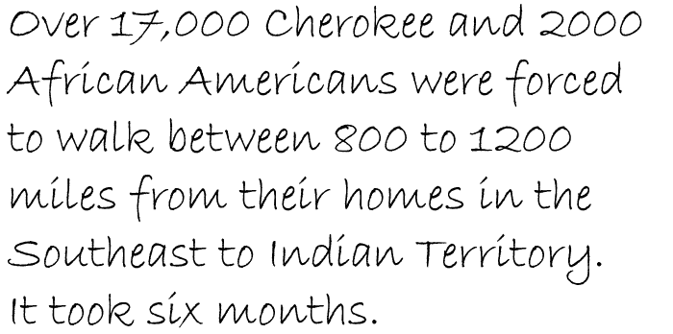
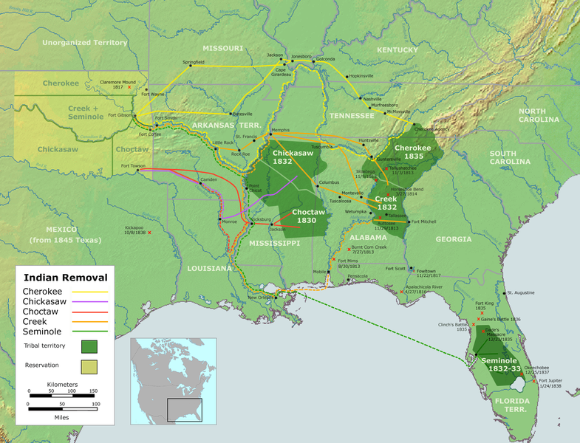


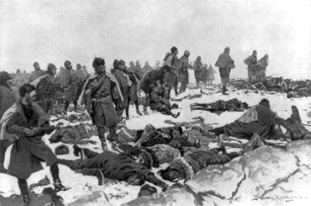

Slide 24

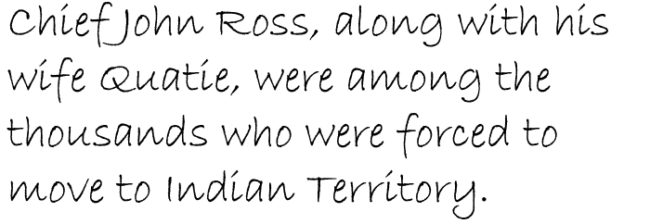

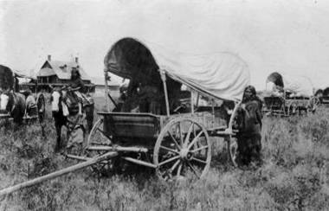
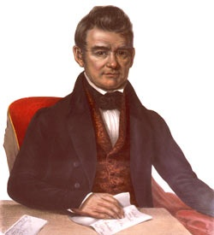
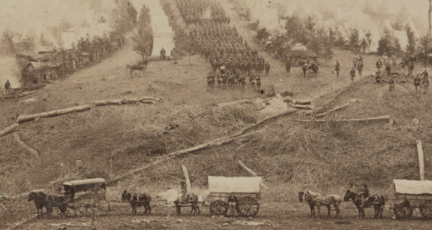

Slide 25

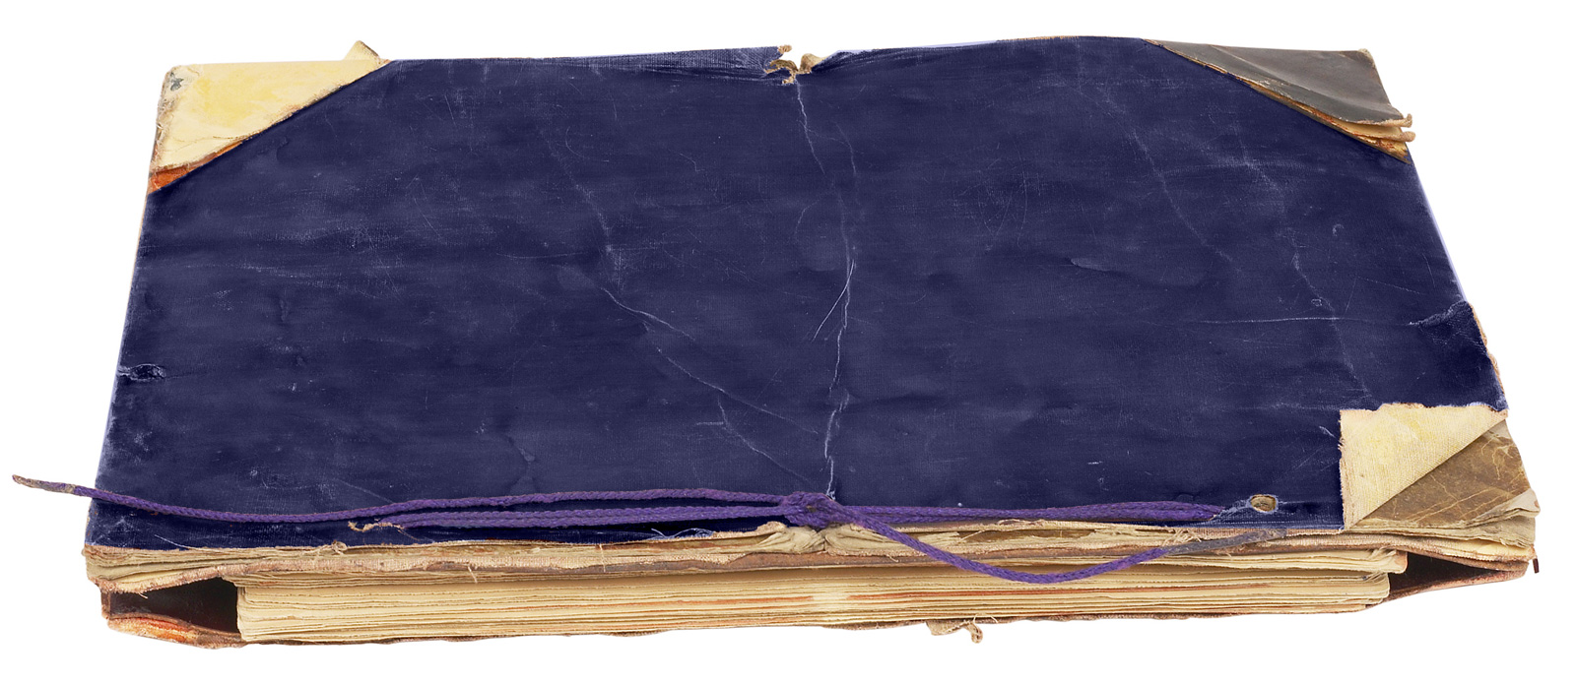

Slide 26
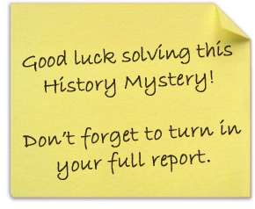

Slide 27


